Slide 1
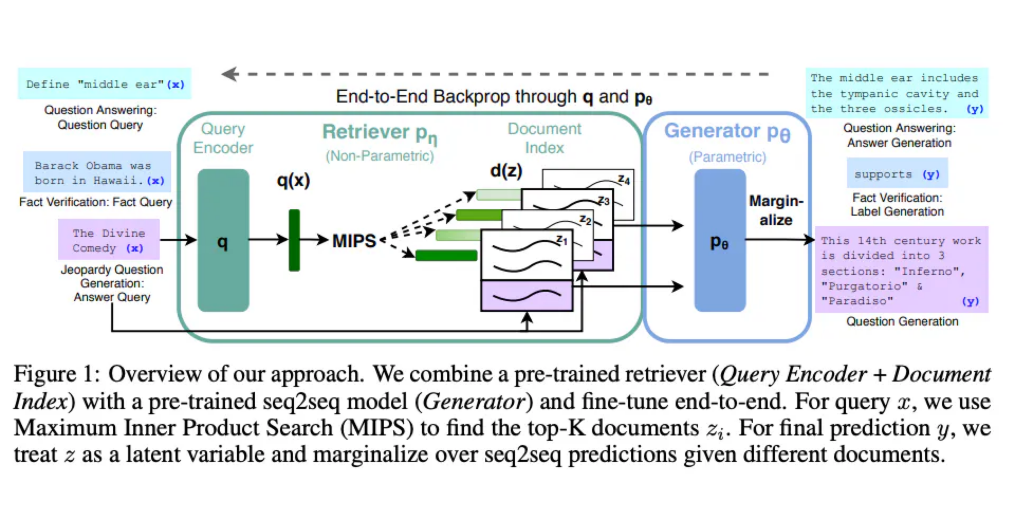
Retrieval Augmented Generation (RAG)

Slide 2
Outline
Prerequisites
Intro into Large Language Models (LLMs)
RAG pipeline
Embedding vectors
Sentence BERT
Vector databases
Clustering algorithms (HNSW)
Structure of the Transformer model
How attention mechanism works
BERT
MLM task
[CLS] token

Slide 3
What is a Language Model?
A Language Model is a probabilistic model that assigns probabilities to sequences of words. In practice, a Language Model allows us to compute the following:
P [ “China” | “Shanghai is a city in” ]
We usually train a neural network to predict these probabilities. A neural network trained on a large corpora of text is known as a Large Language Model (LLM).
Next Token
Prompt

Slide 4
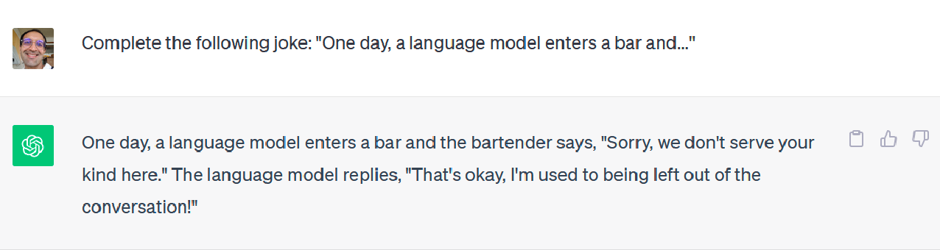
How do we train and perform inference on a Language Model?
Training
A Language Model is trained on a corpora of text, that is, a large collection of documents. Often, Language Models are trained on entire Wikipedia and millions of web pages. This allows the Language Model to acquire as much knowledge as possible. We usually train Transformer-based neural networks as Language Models.
Inference
To perform inference, we construct a prompt and let the Language Model generate the rest by iteratively adding tokens.

Slide 5
You Are What You Eat
A language model can only output text and information that it was trained upon. This means that if we train a language model only on English content, it is very likely that it won’t be able to output Japanese or French. To teach new concepts, we need to fine-tune the model.

Slide 6
The Cons of Fine-tuning
It can be expensive
The number of parameters of the model may not be sufficient to capture all the knowledge we want to teach it. That’s why LLaMA was introduced with 7B, 13B and 70B parameters.
Fine-tuning is not additive. It may replace existing knowledge of the model with new knowledge. For example, a language model trained on English that is (heavily) fine-tuned on Japanese may “forget” some English.

Slide 7
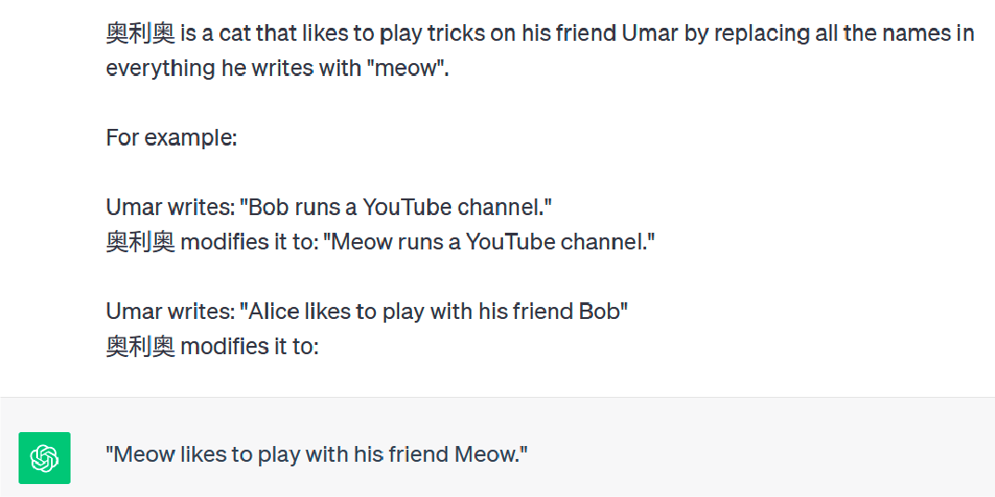
Prompt Engineering to the rescue!
It is possible to “teach” a language model how to perform a new task by playing with the prompt. For example, by using “few-shot” prompting. The following is an example:

Slide 8
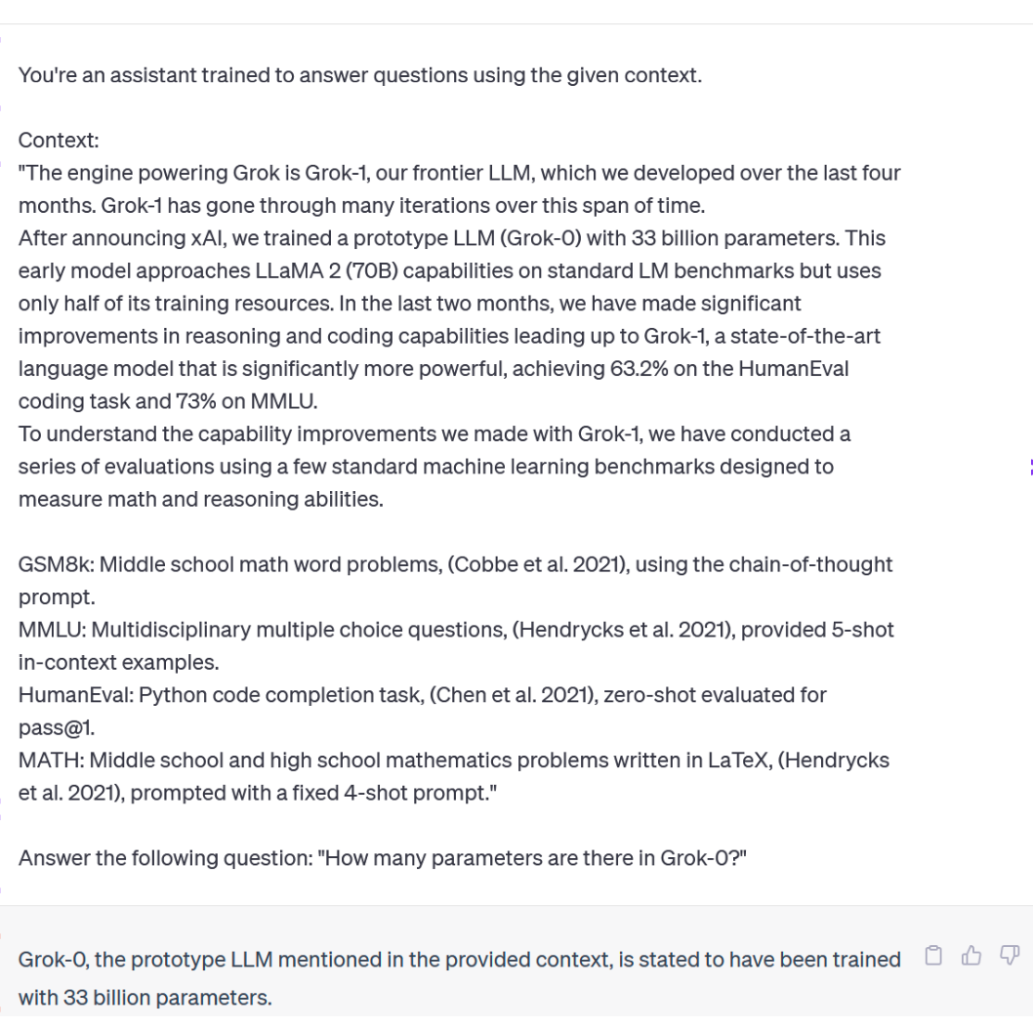
Question Answering (QA) with Prompt Engineering
Instructions
Context
Prompt
Question
Answer

Slide 9
The Pros of Fine-tuning
Higher quality results compared to prompt engineering
Smaller context size (input size) during inference since we don’t need to include the context and instructions

Slide 10
QA with Retrieval Augmented Generation
How many parameters are there in Grok-0?
You’re an assistant trained to answer questions using the given context.
Context:
{context}
Answer the following question: {query}
Query
Documents
Web Pages
LLM
Embeddings
Prompt Template
Split into chunks
Search
Embeddings
Vector DB
Answer
Store
Top-K
Context
Grok-0, the prototype LLM mentioned in the provided context, is stated to have been trained with 33 billion parameters.
[...]
After announcing xAI, we trained a prototype LLM (Grok-0) with 33 billion parameters. This early model approaches LLaMA 2 (70B) capabilities on standard LM benchmarks but uses only half of its training resources.
[...]

Slide 11
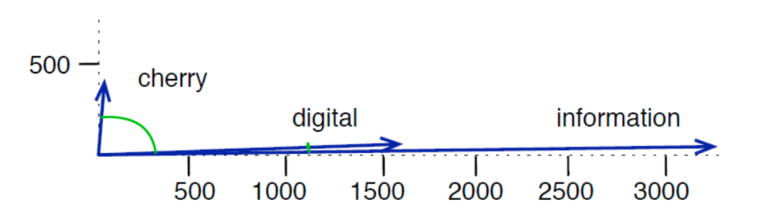
Why do we use vectors to represent words?
Given the words “cherry”, “digital” and “information”, if we represent the embedding vectors using only 2 dimensions (X, Y) and we plot them, we hope to see something like this: the angle between words with similar meaning is small, while the angle between words with different meaning is big. So, the embeddings “capture” the meaning of words they represent by projecting them into a high-dimensional space.
We commonly use the cosine similarity, which is based on the dot product between the two vectors.

Slide 12
Word Embeddings: The Ideas
Words that are synonymous tend to occur in the same context (surrounded by the same words).
For example, the word “teacher” and “professor” usually occur in the same context and surrounded by the same words like ”school”, “university”, “exam”, “lecture”, “course”, etc.
The inverse can also be true: words that occur in the same context tend to have similar meanings. This is known as distributional hypothesis.
This means that to capture the meaning of the word, we also need to have access to its context (the word surrounding it).
This is why we employ the Self-Attention mechanism in the Transformer model to capture contextual information of every token. The Self-Attention mechanism relates every token to all the other tokens in the sentence.

Slide 13
Word Embeddings: The Cloze Task
Imagine I give you the following sentence: Rome is the _______ of Italy, which is why it hosts many government buildings. Can you tell me the missing word?
Of course! The missing word is “capital”, because by looking at the rest of the sentence, it is the one that makes the most sense.
This is how we train BERT: we want the Self-Attention mechanism to relate all the input tokens with each other, so that BERT has enough information about the “context” of the missing word to predict it.

Slide 14
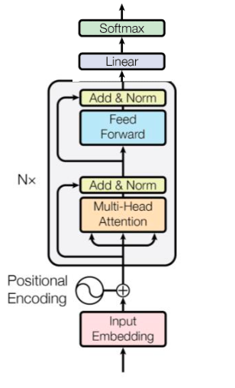
How do we train embedding vectors in BERT?
Target (1 token)
capital
Loss
Run backpropagation to update weights
Output (14 tokens)
TK1
TK2
TK3
TK4
TK5
TK6
TK7
TK8
TK9
TK10
TK11
TK12
TK13
TK14
Input (14 tokens)
Rome is the [mask] of Italy, which is why it hosts many government buildings.

Slide 15
Sentence Embeddings
We can use Self-Attention mechanism also to capture the ”meaning” of an entire sentence
We can use a pre-trained BERT model to produce embeddings of entire sentences. Let’s see how

Slide 16
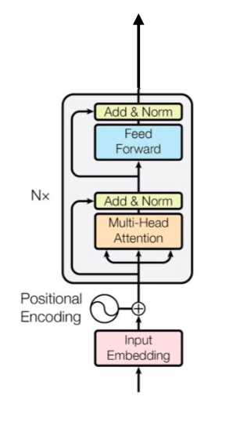
Sentence Embeddings with BERT
Sentence Embedding
Single vector of 768 dimensions
Mean-Pooling: take the average of all the vectors
Output (13 tokens)
TK1
TK2
TK3
TK4
TK5
TK6
TK7
TK8
TK9
TK10
TK11
TK12
TK13
Output of the Self-Attention: matrix of shape (13, 768)
Input of the Self-Attention: matrix of shape (13, 768)
Input (13 tokens)
Our professor always gives us lots of assignments to do in the weekends.

Slide 17
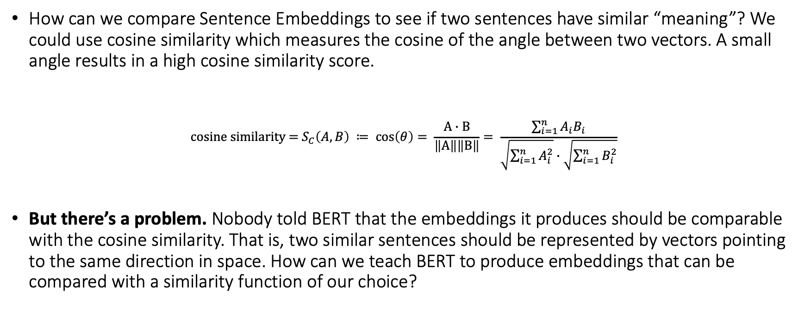
Sentence Embeddings: Similarity Comparison
How can we compare Sentence Embeddings to see if two sentences have similar “meaning”? We could use cosine similarity which measures the cosine of the angle between two vectors. A small angle results in a high cosine similarity score.
$$c\text{osine} \text{similarity}\text{ = }S_{C}\left(A, B\right) ≔ \cos\left(θ\right)= \frac{Α∙Β}{\left\|Α\right\|\left\|Β\right\|}= \frac{\sum_{i=1}^{n}{A_{i}B_{i}}}{\sqrt{\sum_{i=1}^{n}{A_{i}^{2}}}∙\sqrt{\sum_{i=1}^{n}{B_{i}^{2}}}}$$
But there’s a problem. Nobody told BERT that the embeddings it produces should be comparable with the cosine similarity. That is, two similar sentences should be represented by vectors pointing to the same direction in space. How can we teach BERT to produce embeddings that can be compared with a similarity function of our choice?

Slide 18
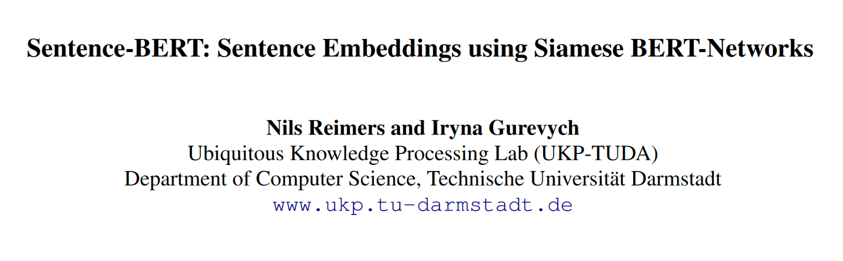
Introducing Sentence BERT

Slide 19

Sentence BERT: Architecture
Cosine Similarity (Target)
Loss (MSE)
Cosine Similarity
Sentence Embedding A
Sentence Embedding B
We can apply a linear layer to reduce the size of the embedding vector. For example, from 768 to 512.
Siamese Network
Same architecture
Same parameters
Same weights
We can use mean-pooling or max-pooling or simply use the [CLS] token as the sentence embedding.
Pooling
Pooling
BERT
BERT
Sentence A
Sentence B
“My father plays with me at the park”
“I play with my dad at the park”

Slide 20
QA with Retrieval Augmented Generation
How many parameters are there in Grok-0?
You’re an assistant trained to answer questions using the given context.
Context:
{context}
Answer the following question: {query}
Query
Documents
Web Pages
LLM
Embeddings
Prompt Template
Split into chunks
Search
Embeddings
Vector DB
Answer
Store
Top-K
Context
Grok-0, the prototype LLM mentioned in the provided context, is stated to have been trained with 33 billion parameters.
[...]
After announcing xAI, we trained a prototype LLM (Grok-0) with 33 billion parameters. This early model approaches LLaMA 2 (70B) capabilities on standard LM benchmarks but uses only half of its training resources.
[...]

Slide 21
Strategies to teach new concepts to LLMs
Base LLM
Base LLM
+
+
Fine-tune (on custom data)
Vector DB + Embeddings
=
=
Fine-tuned LLM
RAG
Fine-tuned LLM + RAG

Slide 22
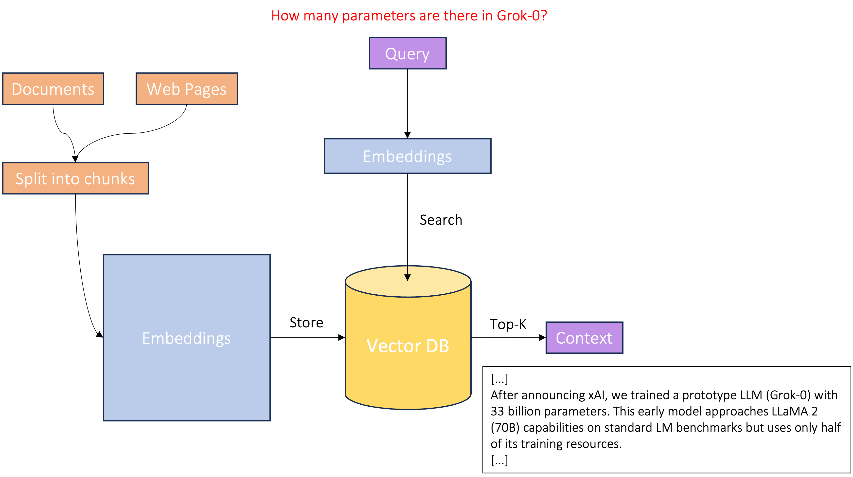
Vector DB: Introduction
A vector database stores vector of fixed dimensions (called embeddings) such that we can then query the database to find all the embeddings that are closest (most similar) to a given query vector using a distance metric, which is usually the cosine similarity, but we can also use the Euclidean distance. The database uses a variant of K-Nearest Neighbors (K-NN) algorithm or another similarity search algorithm. Vector DBs are also used for finding similar songs (e.g. Spotify), images (e.g. Google Photos) or products (e.g. Amazon).

Slide 23


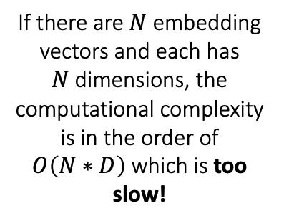
K-NN: A Naïve Approach
Imagine we want to search for the query in our database: a simple way would be comparing the query with all vectors, sorting them by distance, and keeping the top K.
Vector Database
Distances
If there are $Ν$ embedding vectors and each has $Ν$dimensions, the computational complexity is in the order of $O\left(N∗D\right)$which is too slow!
Embedding 1
Distance 1
How many parameters are there in Grok-0?
Embedding 2
Distance 2
Keep top K
Embedding 3
Distance 3
Query
…
…
…
…
Embedding $Ν$
Distance $Ν$

Slide 24
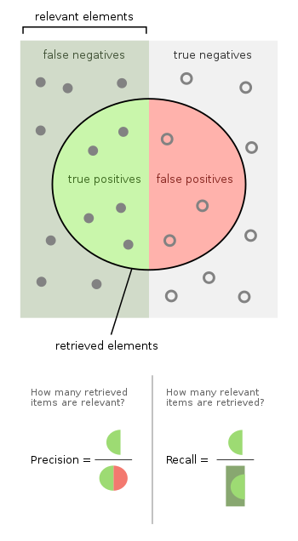
Similarity Search: Let’s trade Precision for Speed
The naïve approach we used before, always produces accurate results, since it compares the query with all the stored vectors, but what if we reduced the number of comparison, but still obtain accurate results with high probability?
The metric we usually care about in Similarity Search is recall.
In this section, we will explore an algorithm for Approximate Nearest Neighbors, called Hierarchical Navigable Small Worlds (HNSW).

Slide 25
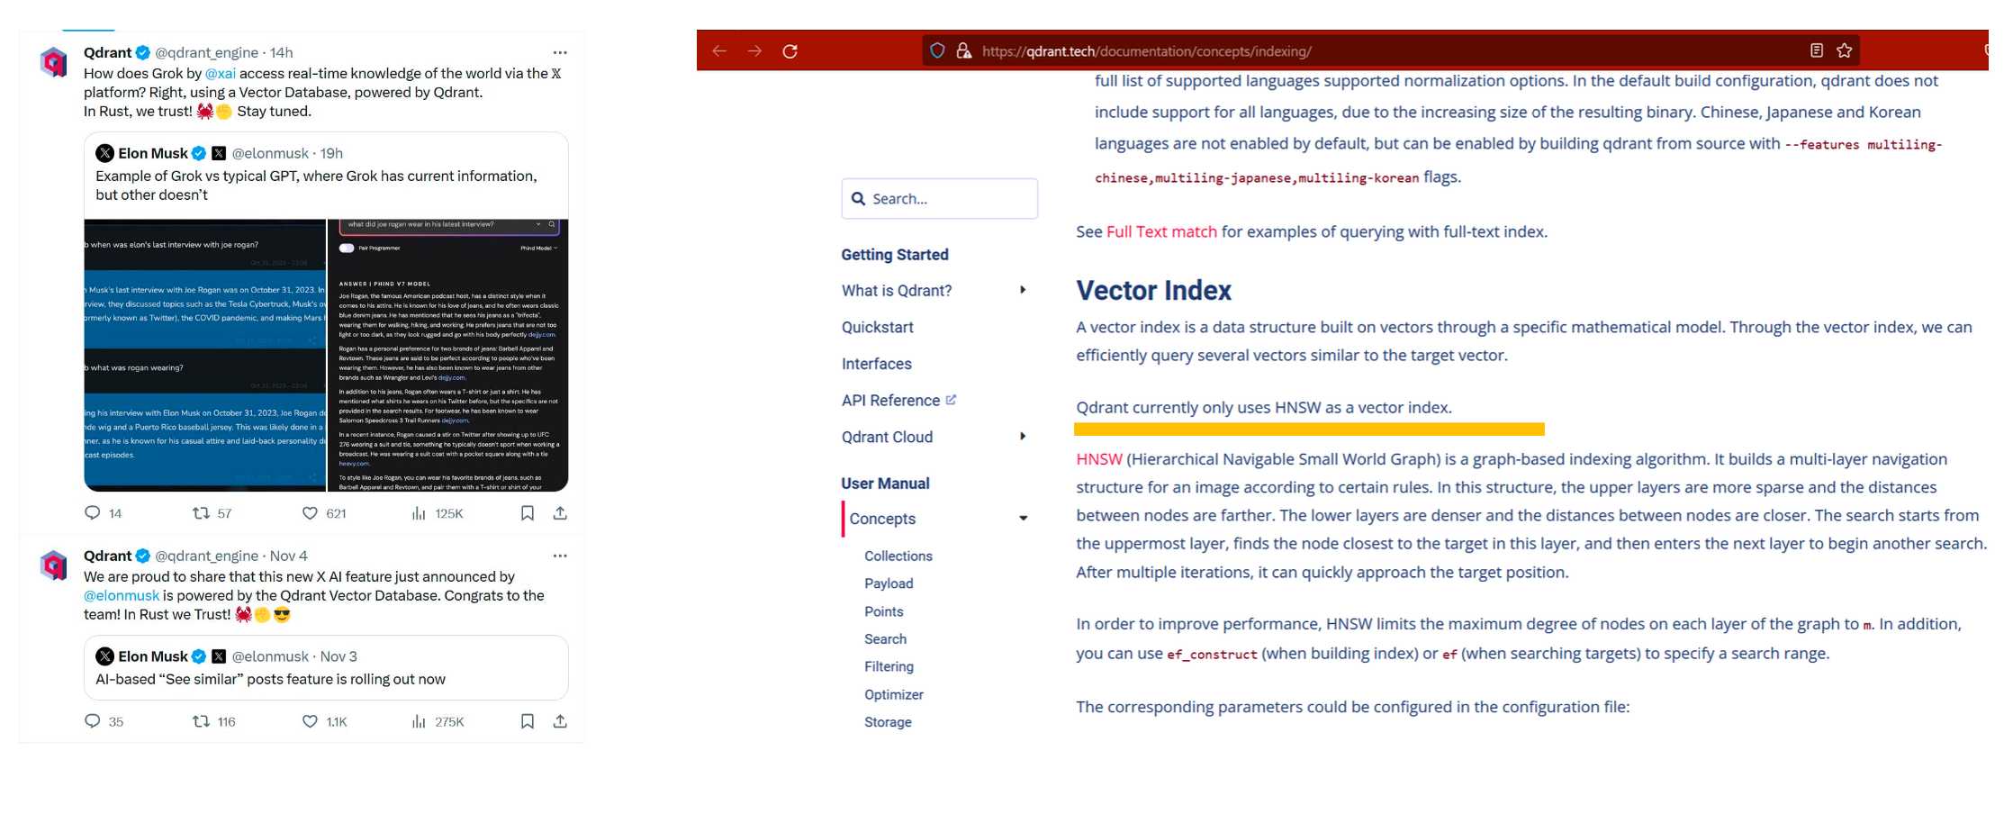
HNSW in the real world
It is the same algorithm that powers Qdrant, the open-source Vector DB used by Twitter’s (X) Grok LLM, which can access tweets in real time.

Slide 26
HNSW: Idea #1
HNSW is an evolution of the Navigable Small Worlds algorithm for Approximate Nearest Neighbors, which is based on the concept of Six Degrees of Separation.
Milgram’s experiment aimed to test the social connections among people in the United States. The participants, who were initially located in Nebraska and Kansas, were given a letter to be delivered to a specific person in Boston. However, they were not allowed to send the letter directly to the recipient. Instead, they were instructed to send it to someone they knew on a first-name basis, who they believed might have a better chance of knowing the target person.
At the end of Milgram’s small-world experiment, Milgram found that most of the letters reached the final recipient in five or six steps, creating the concept that people all over the world are connected by six degrees of separation.
Facebook found in 2016 that its 1.59 billion active users were connected on average by 3.5 degrees of separation: Link
This means that you and Mark Zuckerberg are only 3.5 connections apart!

Slide 27
Navigable Small Worlds
The NSW algorithm builds a graph that — just like Facebook friends — connects close vectors with each other but keeping the total number of connections small. For example, every vector may be connected to up to 6 other vectors (to mimic Six Degrees of Separation).
Node | Text
01 | [...] The Transformer is a model [...]
02 | [...] Diagnose cancer with AI [...]
03 | [...] A transformer-based model [...]
04 | [...] The Transformer has 6 layers [...]
05 | [...] An MRI machine that costs $1 [...]
06 | [...] The dot-product is a [...]
07 | [...] Big-Pharma is not so big [...]
08 | [...] Cross-Attention is a great [...]
09 | [...] To solve an ODE [...]
10 | [...] We are aging too fast [...]
11 | [...] Open-source models like [...]
12 | [...] MathBERT: A new model [...]
13 | [...] AI to control aging [...]
05
07
10
02
13
01
09
04
08
11
15
03
12
14
06

Slide 28
Navigable Small Worlds: Searching for K-NN
Given the following query: “How many Encoder layers are there in the Transformer model?” How does the algorithm find the K Nearest Neighbors?
Q
Randomly chosen entry point
Node | Text
01 | [...] The Transformer is a model [...]
02 | [...] Diagnose cancer with AI [...]
03 | [...] A transformer-based model [...]
04 | [...] The Transformer has 6 layers [...]
05 | [...] An MRI machine that costs $1 [...]
06 | [...] The dot-product is a [...]
07 | [...] Big-Pharma is not so big [...]
08 | [...] Cross-Attention is a great [...]
09 | [...] To solve an ODE [...]
10 | [...] We are aging too fast [...]
11 | [...] Open-source models like [...]
12 | [...] MathBERT: A new model [...]
13 | [...] AI to control aging [...]
05
07
10
02
13
01
Local best: stop search
09
04
08
11
15
03
12
14
06
We repeat the search with randomly chosen starting points and then keep the top K among all the visited nodes.

Slide 29
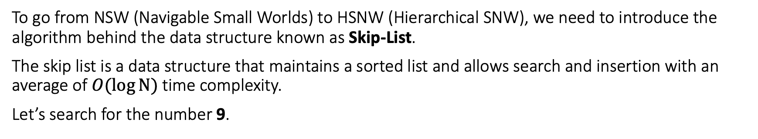
HNSW: Idea #2
To go from NSW (Navigable Small Worlds) to HSNW (Hierarchical SNW), we need to introduce the algorithm behind the data structure known as Skip-List.
The skip list is a data structure that maintains a sorted list and allows search and insertion with an average of $O(\log{Ν})$ time complexity.
Let’s search for the number 9.
H₃
E
H₂
E
H₁
E
H₀
E
1
5
3
9
12
17
23

Slide 30

HNSW: Hierarchical Navigable Small Worlds

Slide 31
HNSW: Hierarchical Navigable Small Worlds
Let’s search!
Q
Randomly chosen entry point
Local best: go down
Layer 3 (Sparse)
We repeat the search with randomly chosen starting points (on top layer) and then keep the top K among all the visited nodes.
Local best: go down
Layer 2
Layer 1
Local best: go down
Layer 0 (Dense)
Local best: stop search

Slide 32
QA with Retrieval Augmented Generation
How many parameters are there in Grok-0?
You’re an assistant trained to answer questions using the given context.
Context:
{context}
Answer the following question: {query}
Query
Documents
Web Pages
LLM
Embeddings
Prompt Template
Split into chunks
Search
Embeddings
Vector DB
Answer
Store
Top-K
Context
Grok-0, the prototype LLM mentioned in the provided context, is stated to have been trained with 33 billion parameters.
[...]
After announcing xAI, we trained a prototype LLM (Grok-0) with 33 billion parameters. This early model approaches LLaMA 2 (70B) capabilities on standard LM benchmarks but uses only half of its training resources.
[...]

